Slide 1
Edge Distribution

Slide 2
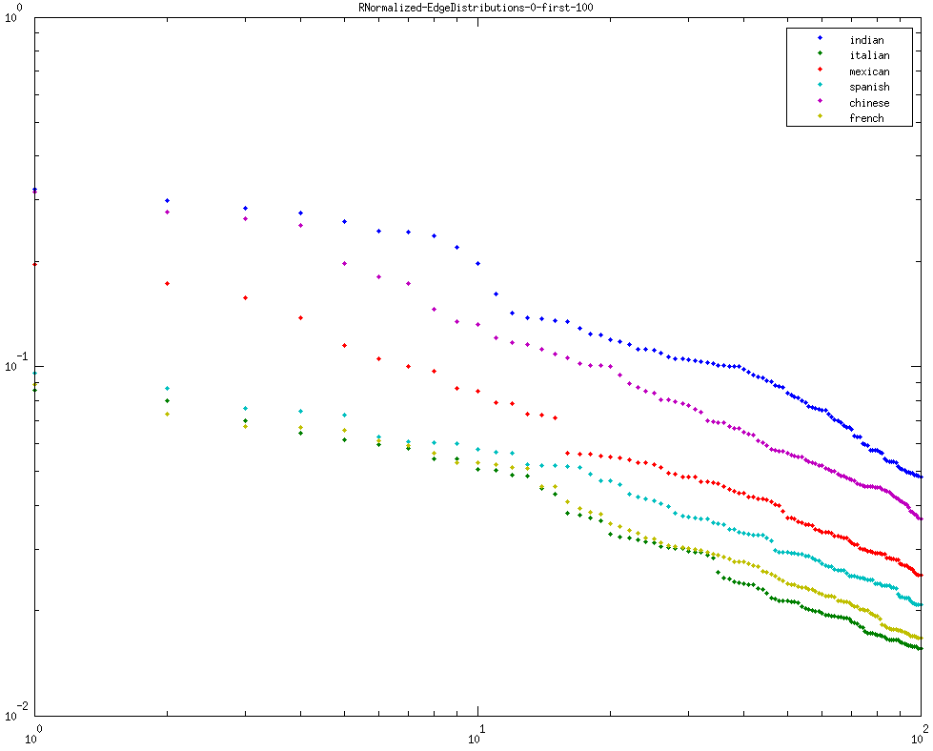
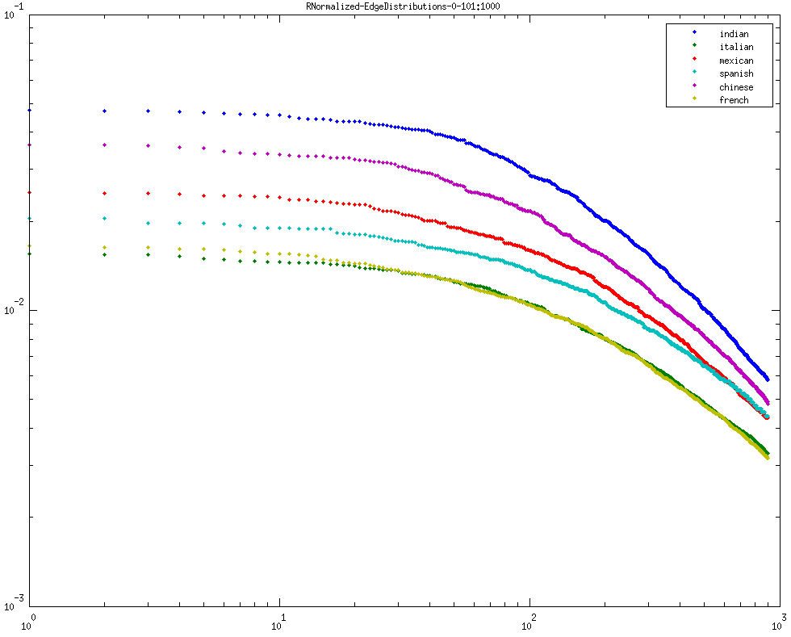
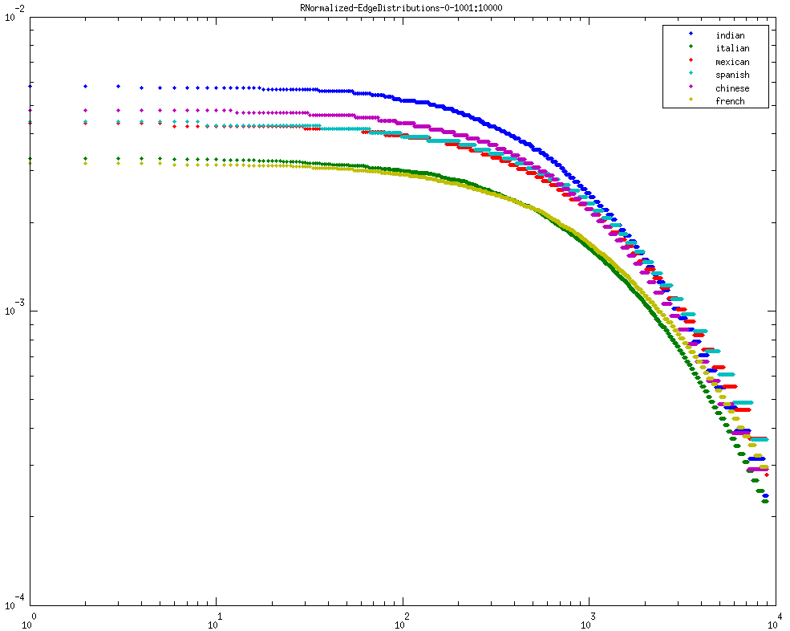
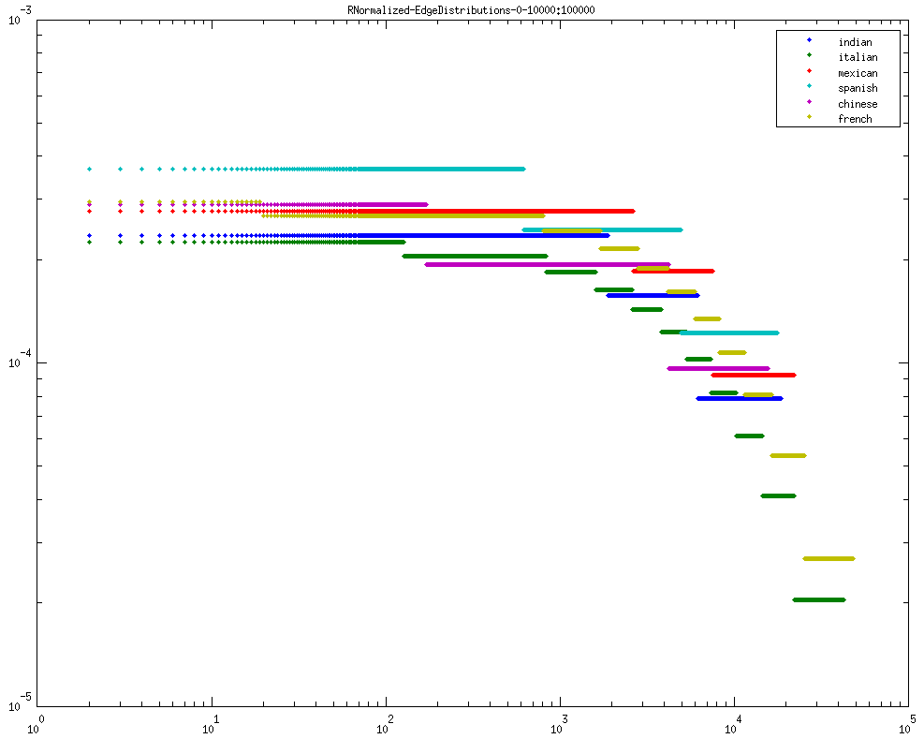
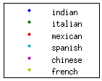
Threshold - 0
L-R
1. first 100 edges
2. 101 - 1000 edges
3. 1001 - 10000 edges
4. 10001 - 100000 edges

Slide 3
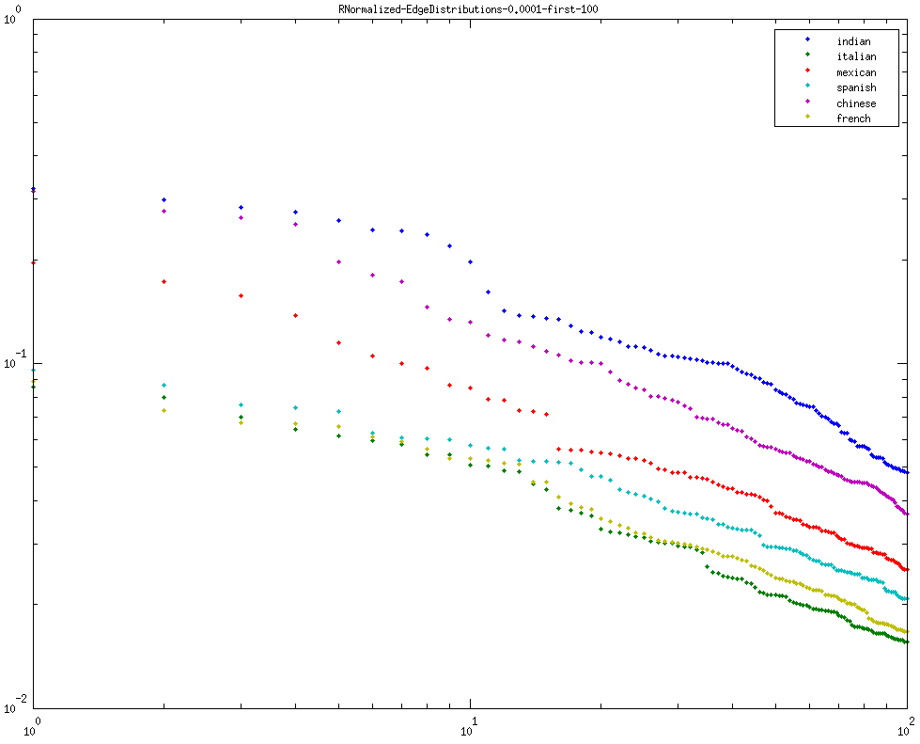
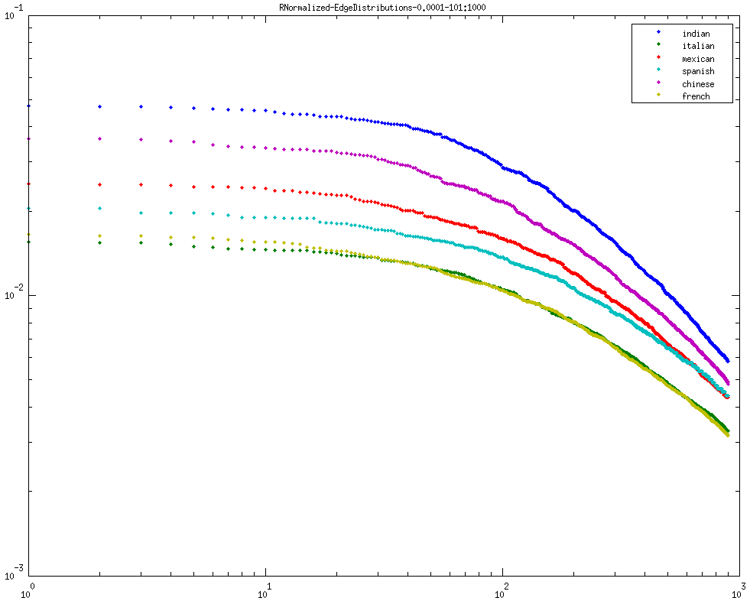
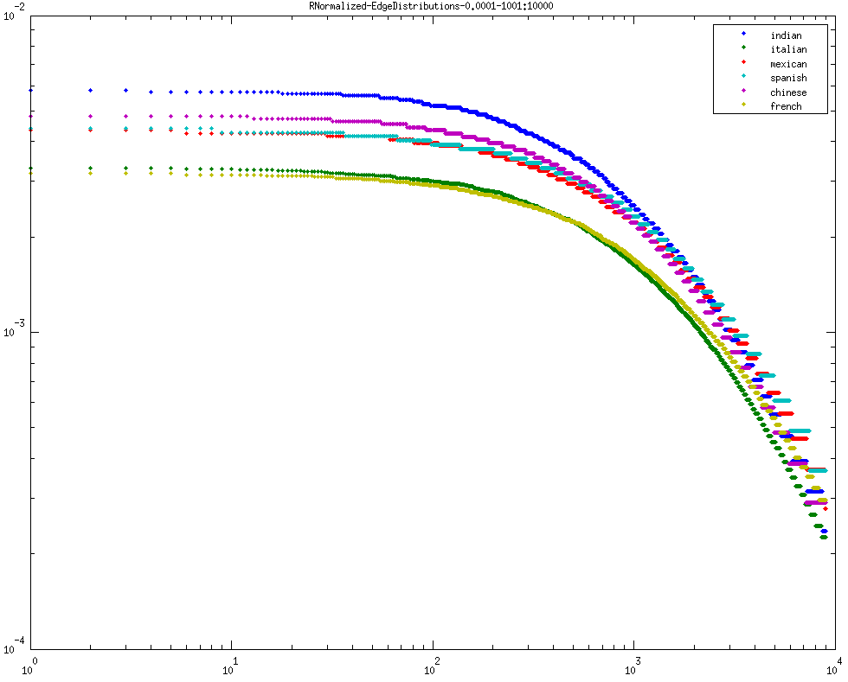
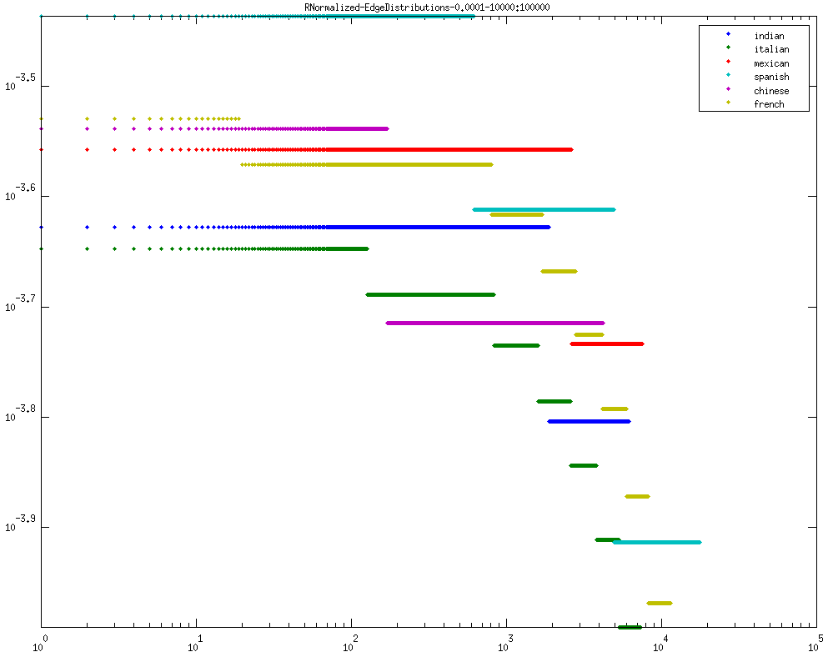
Threshold - 0.0001
L-R
1. first 100 edges
2. 101 - 1000 edges
3. 1001 - 10000 edges
4. 10001 - 100000 edges

Slide 4


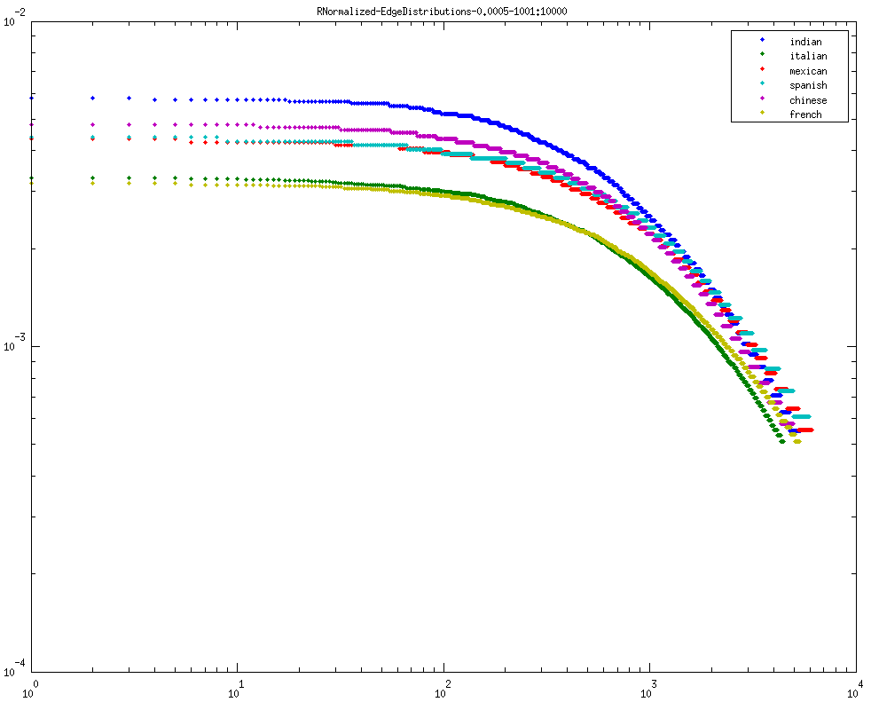
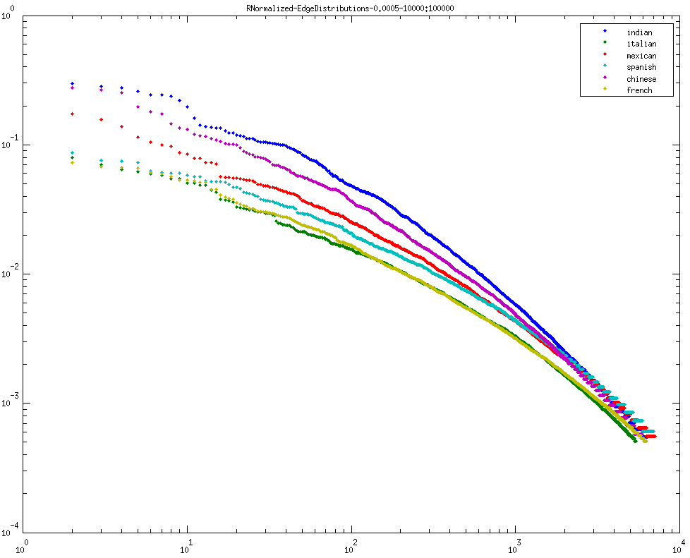
Threshold - 0.0005
L-R
1. first 100 edges
2. 101 - 1000 edges
3. 1001 - 10000 edges
4. 10001 - 100000 edges

Slide 5
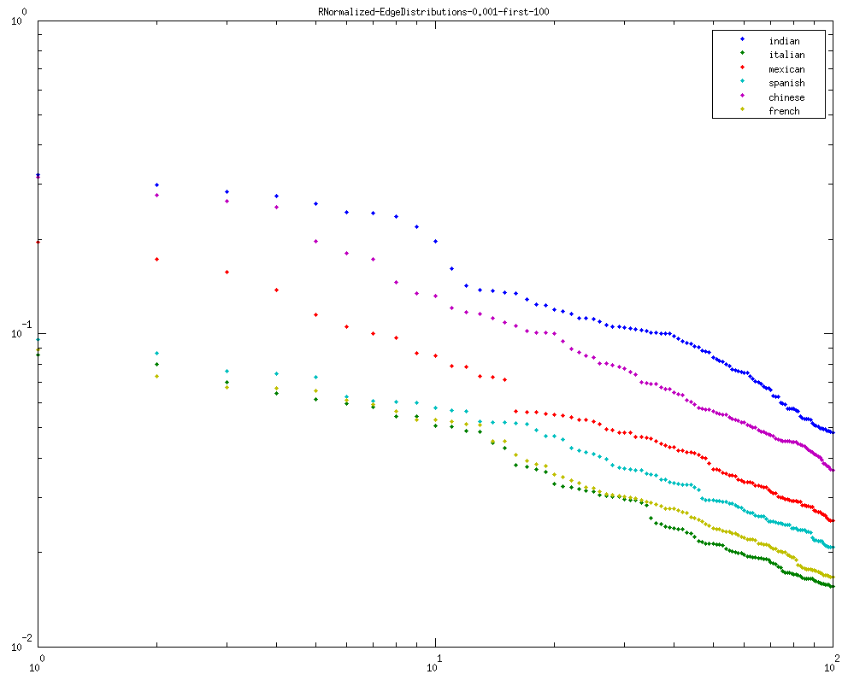
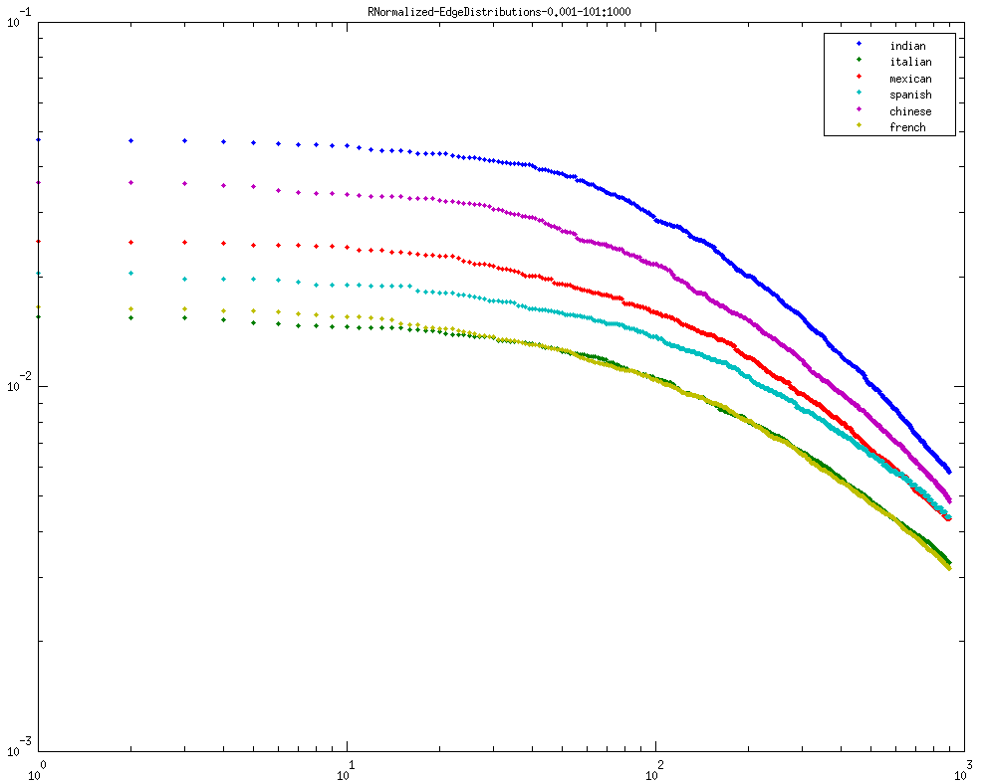
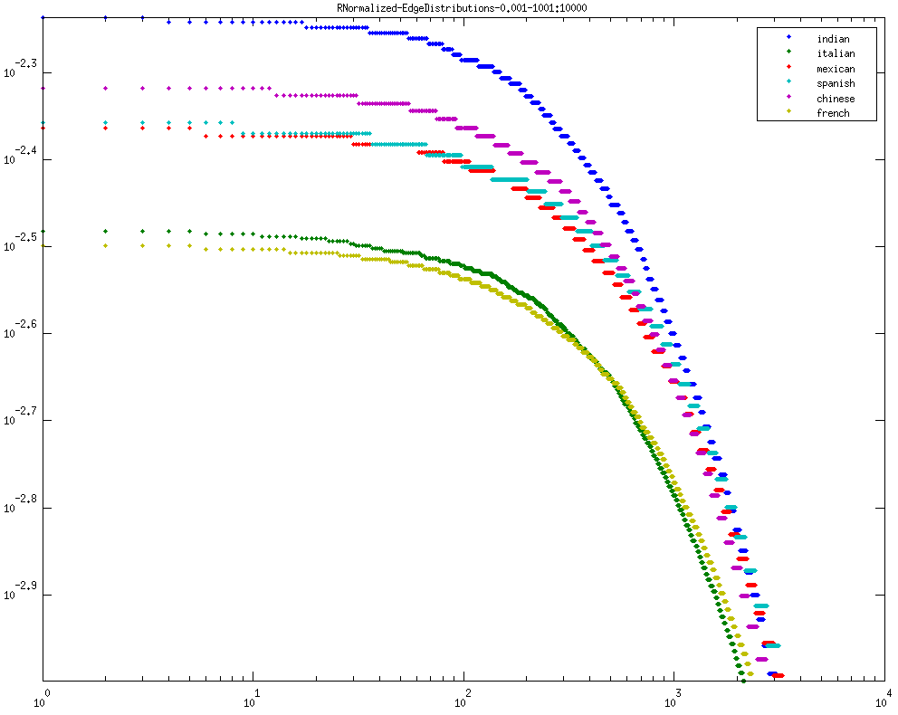
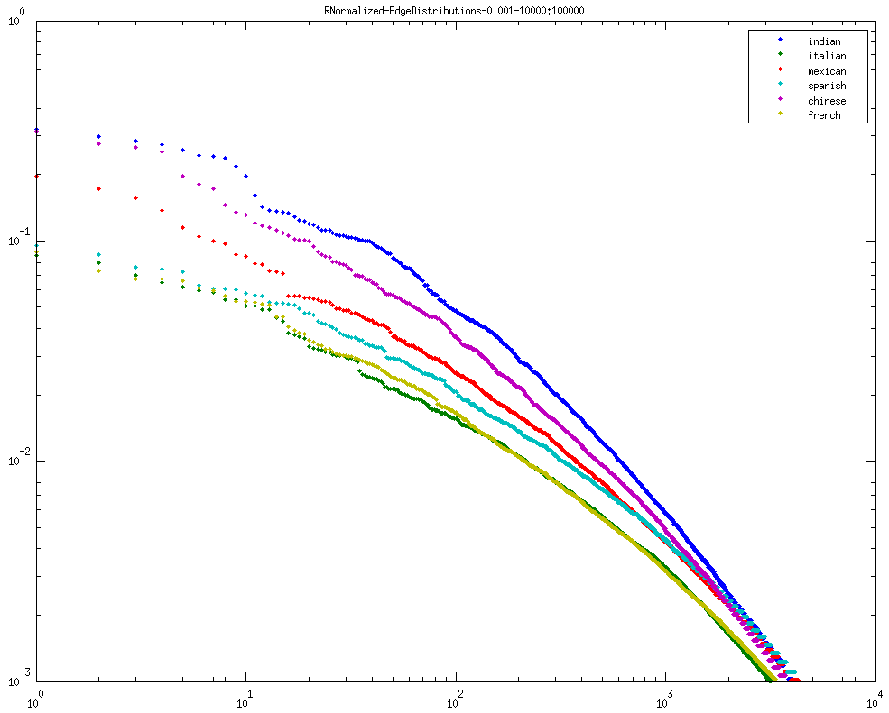
Threshold - 0.001
L-R
1. first 100 edges
2. 101 - 1000 edges
3. 1001 - 10000 edges
4. 10001 - 100000 edges

Slide 6
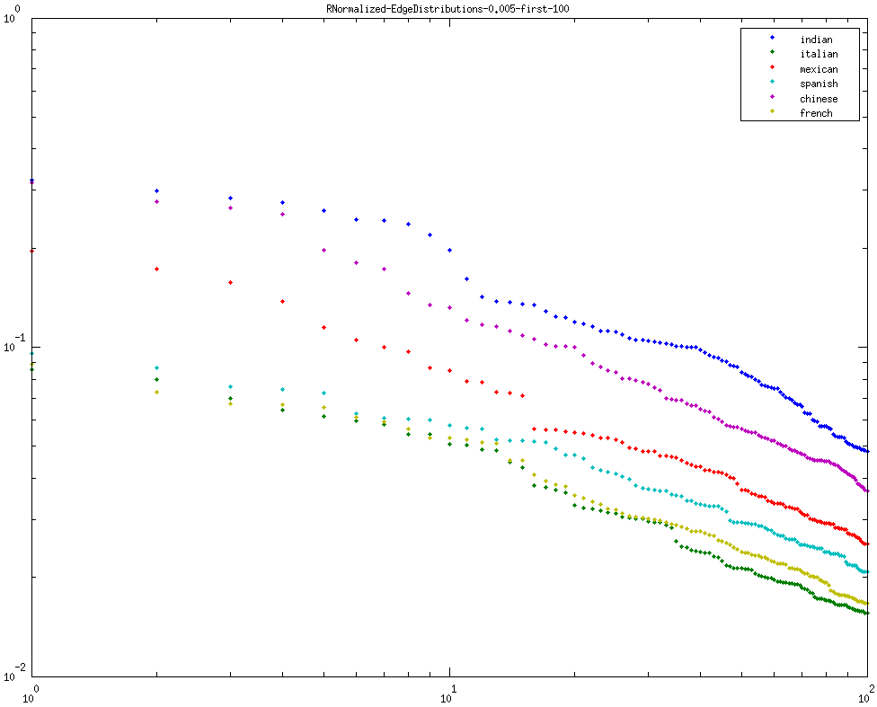
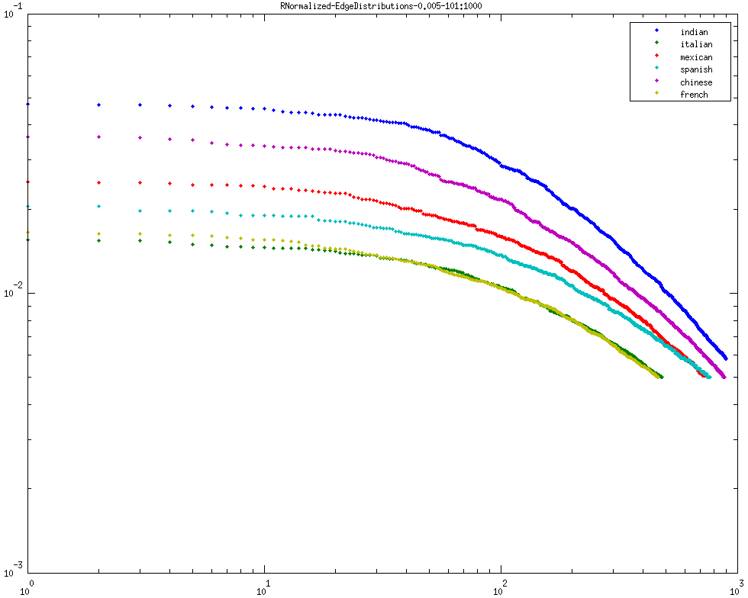
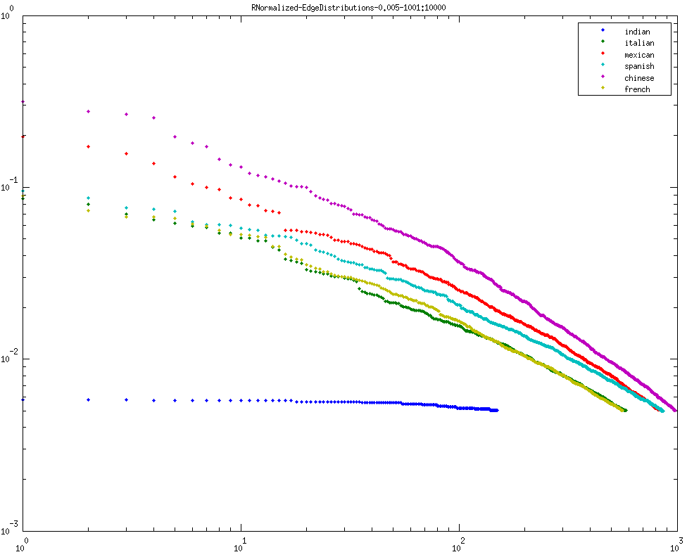
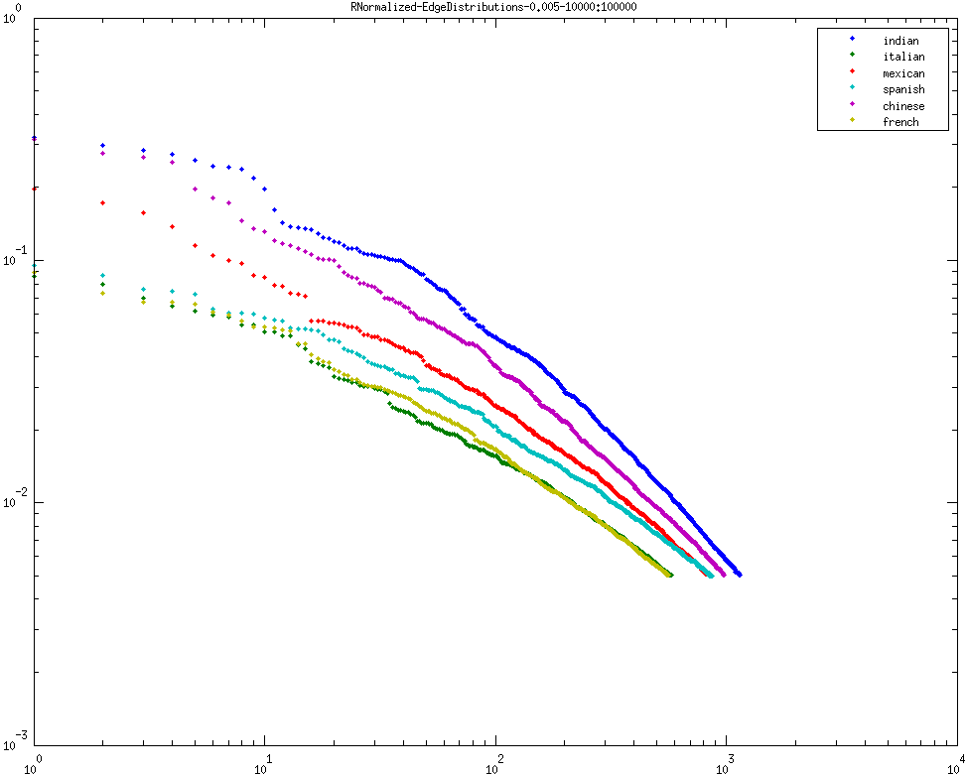
Threshold - 0.005
L-R
1. first 100 edges
2. 101 - 1000 edges
3. 1001 - 10000 edges
4. 10001 - 100000 edges

Slide 7

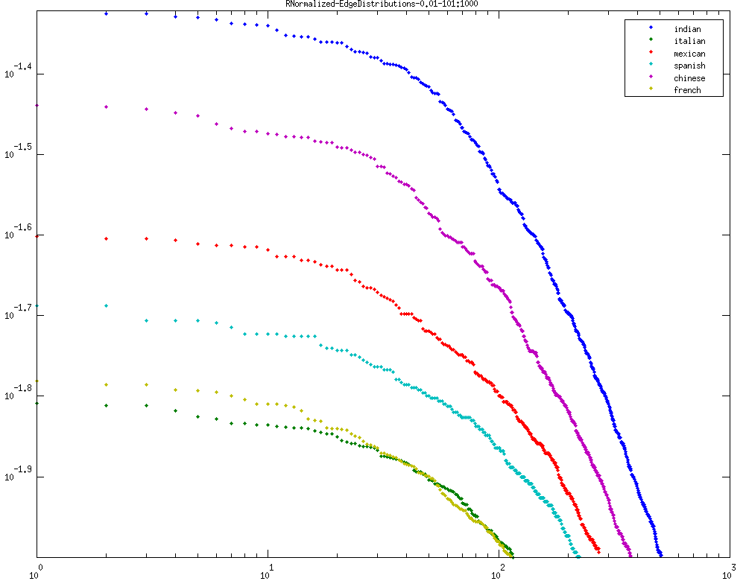
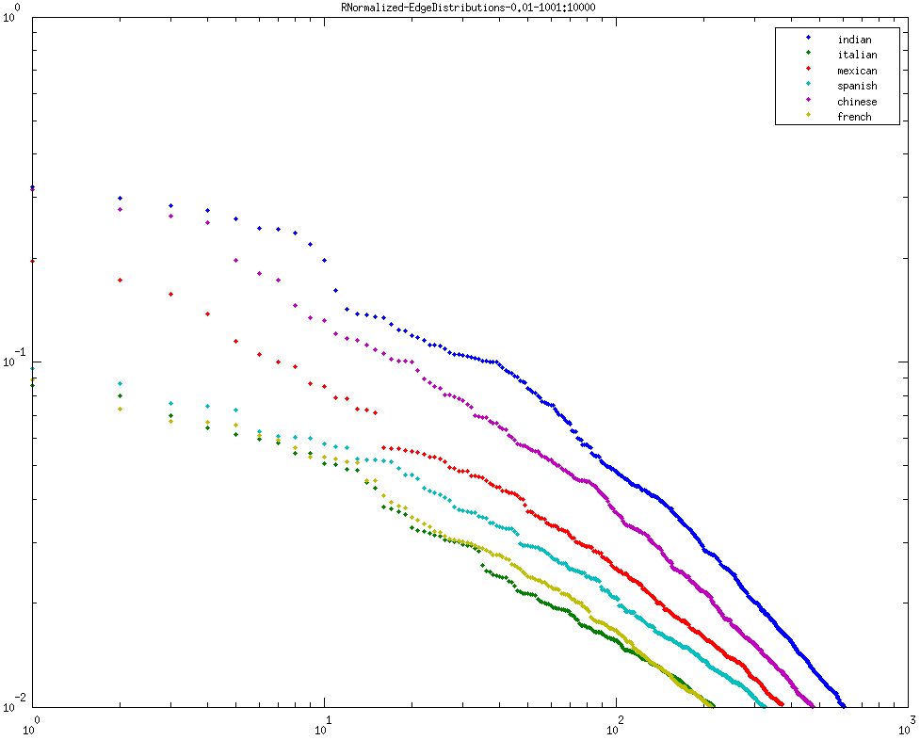
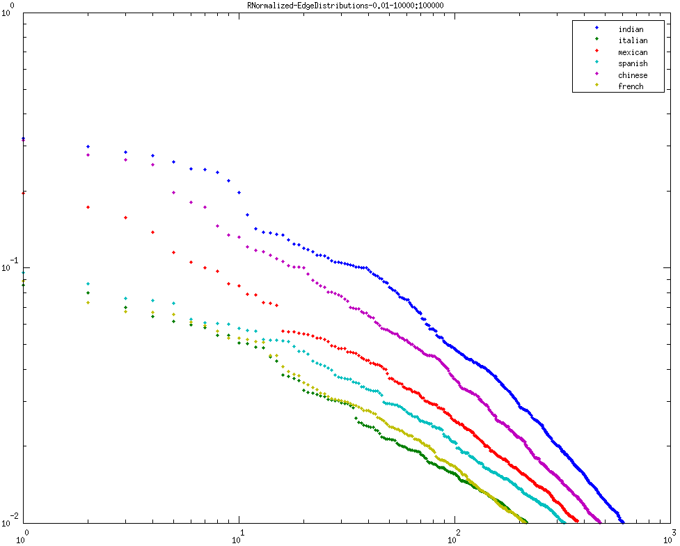
Threshold - 0.01
L-R
1. first 100 edges
2. 101 - 1000 edges
3. 1001 - 10000 edges
4. 10001 - 100000 edges

Slide 8
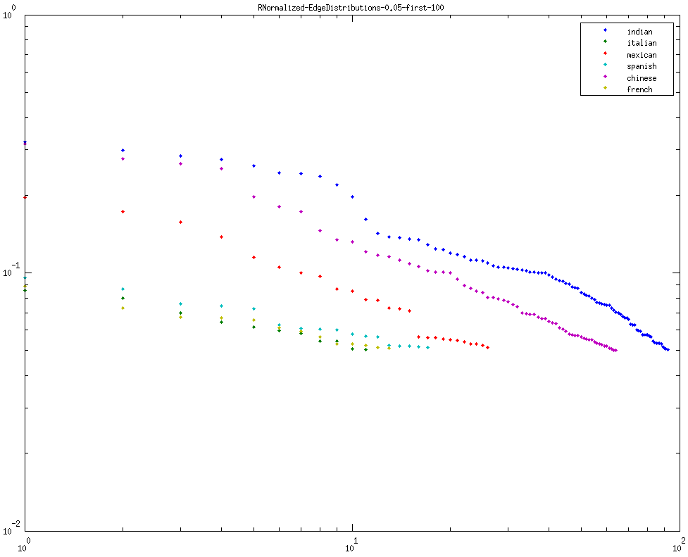

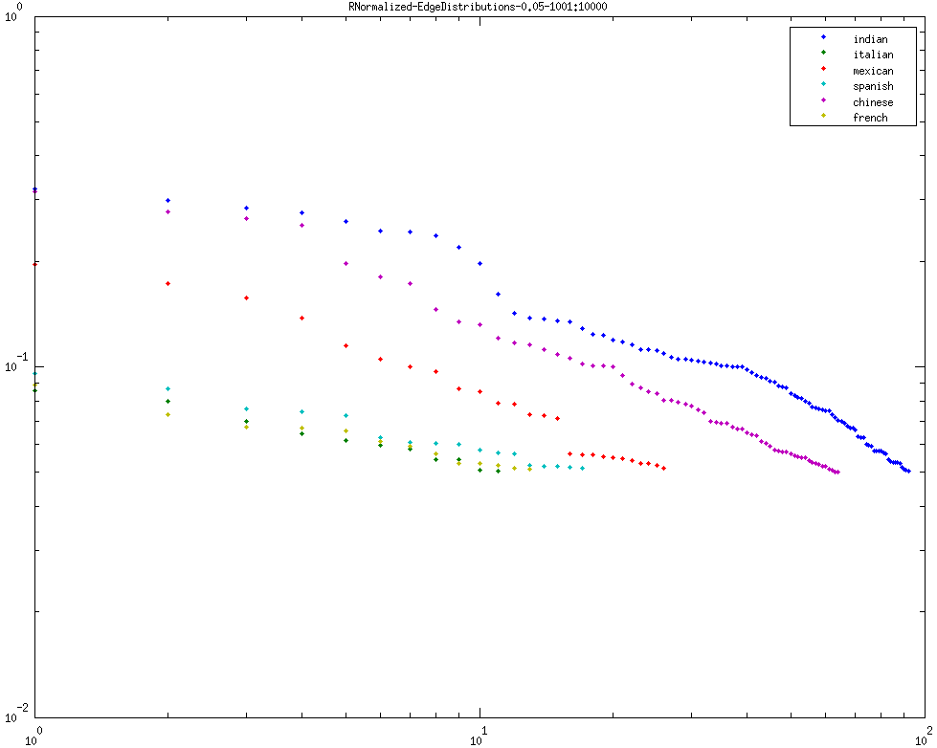

Threshold - 0.005
L-R
1. first 100 edges
2. 101 - 1000 edges
3. 1001 - 10000 edges
4. 10001 - 100000 edges

Slide 9
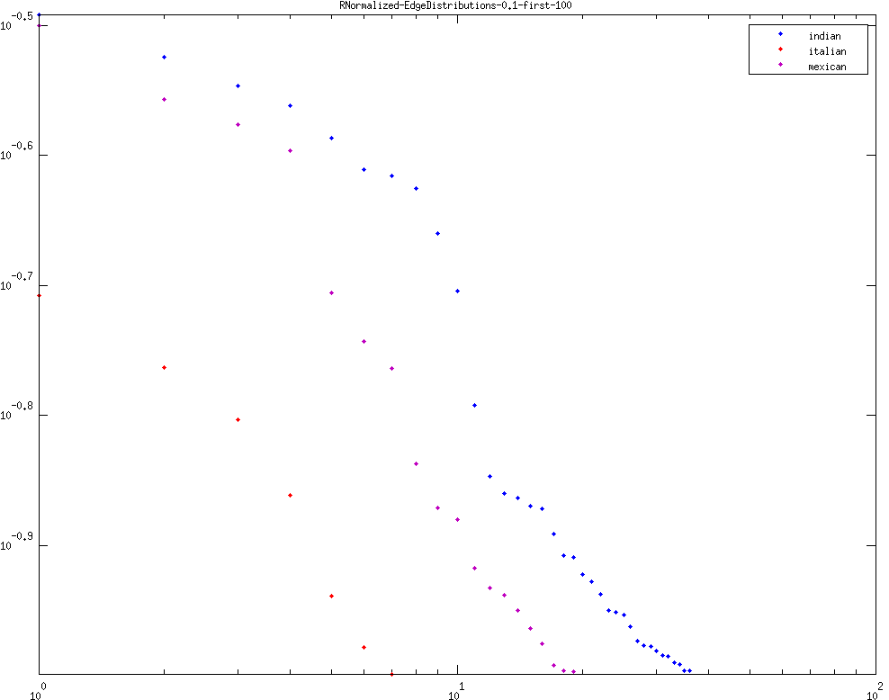
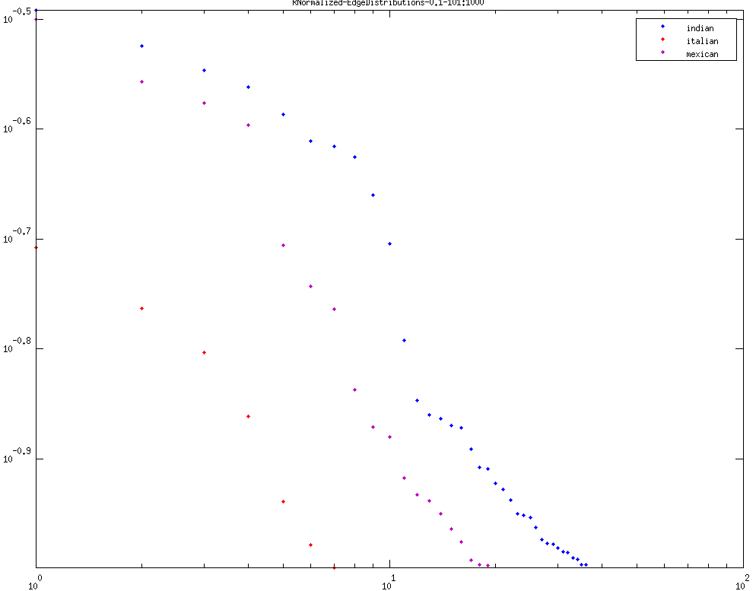
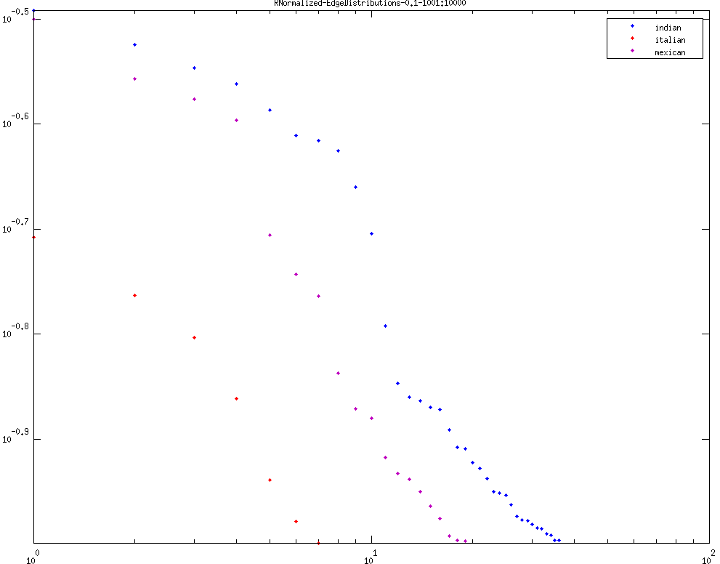
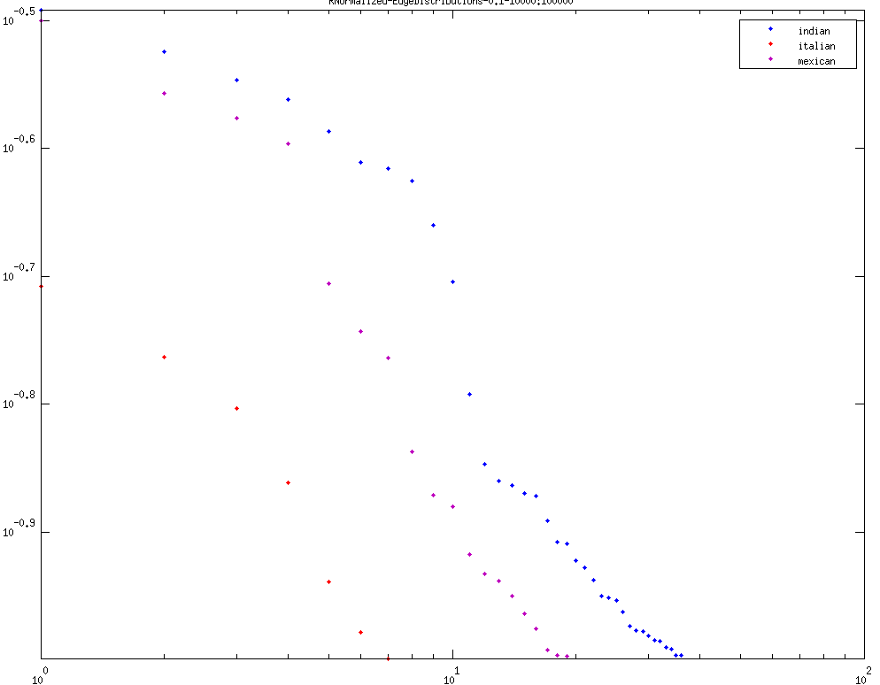
Threshold - 0.1
L-R
1. first 100 edges
2. 101 - 1000 edges
3. 1001 - 10000 edges
4. 10001 - 100000 edges

Slide 10
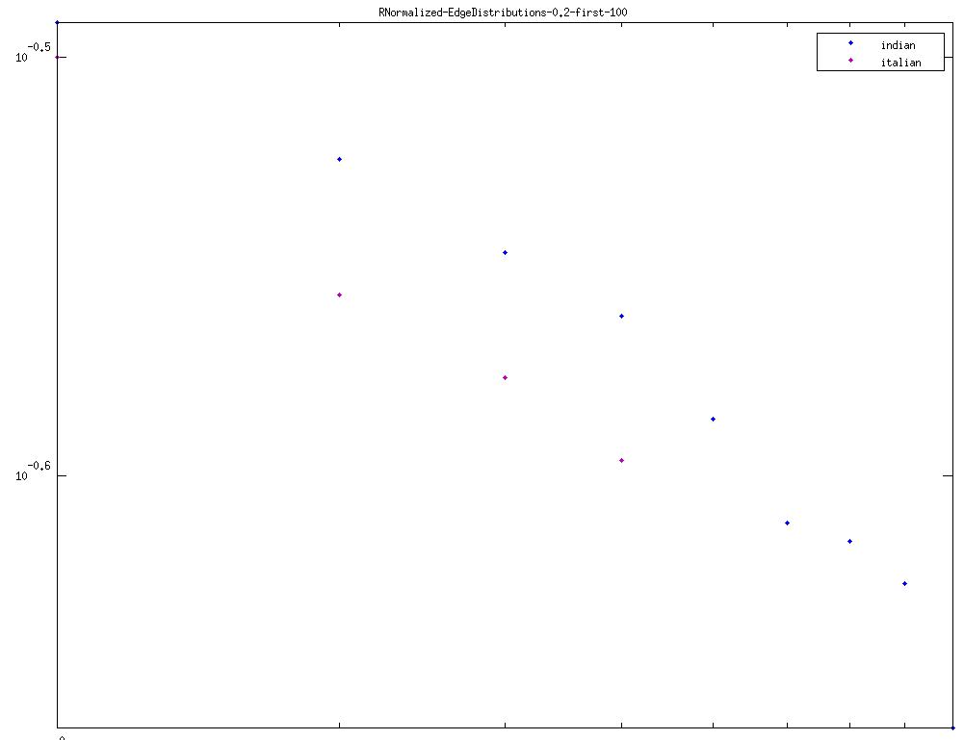
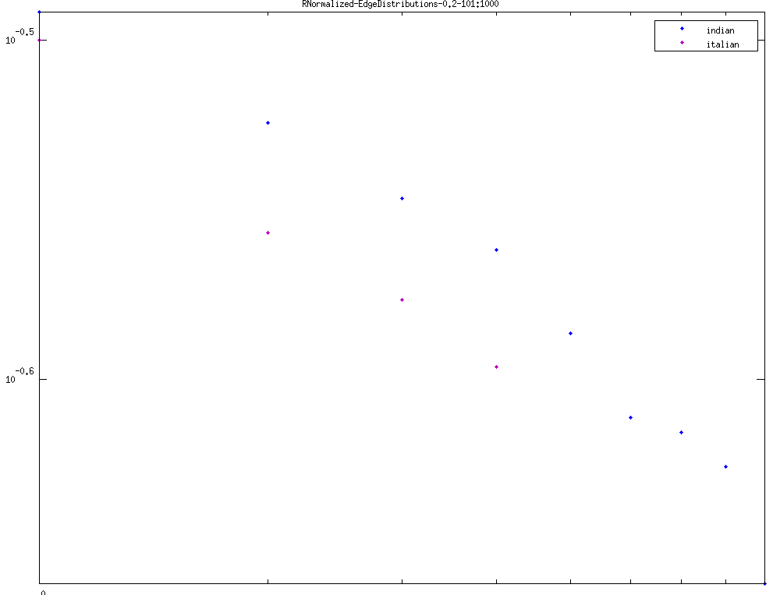
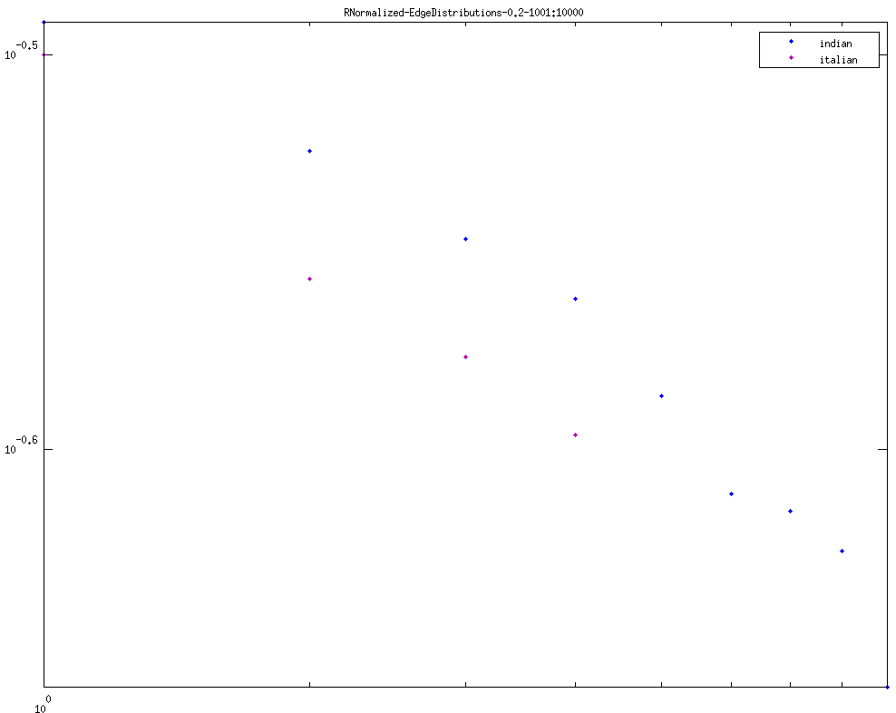
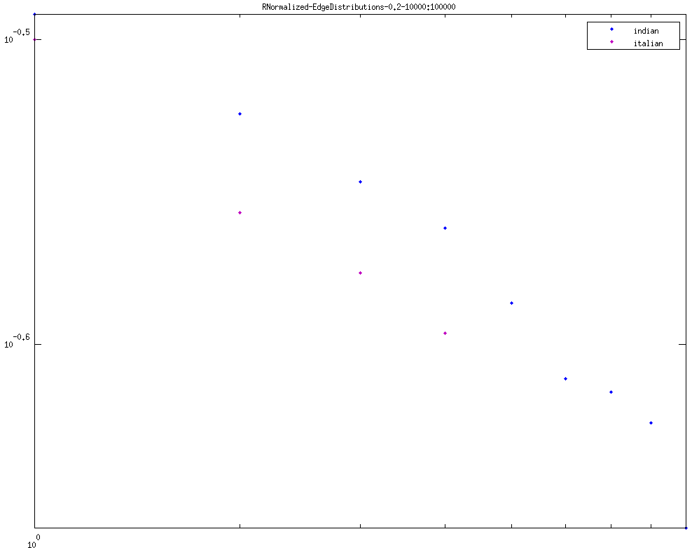
Threshold - 0.2
L-R
1. first 100 edges
2. 101 - 1000 edges
3. 1001 - 10000 edges
4. 10001 - 100000 edges

